Slide 1

Full of Beans HAF Intervention
Winter 2025
Food System Team
Public Health Division, Birmingham City Council
December 2025

Slide 2






What is Full of Beans?
A behaviour change campaign including multiple interventions that aim to increase supply, demand and consumption of beans and pulses across the city.
Objective
To increase the supply, demand and consumption of beans and pulses in Birmingham.
Rationale
We’re on a mission to help everyone discover how amazing beans and pulses are. They may be small, but they are MIGHTY! They are super for our bodies, great for the planet, affordable, convenient, and delicious too!
Our approach
Multi-strand campaign utilising behavioural science with interventions targeting:
Schools and young people
Families and the home
Food businesses
Notes:
For those who aren’t aware of Full of Beans, it is a behaviour change campaign that was launched by the team in 2023, aiming to increase the supply, demand and consumption of beans and pulses across the city. It is a multi-strand campaign utilising behaviour science targeting schools and young people, families and the home and food businesses.

Slide 3

Session Plan
Uploaded onto the Bring it On Brum Portal!
Session overview (2 hours):
Introduce Full of Beans to your club (10 minutes)
Full of Beans warm-up game (15 minutes)
Measuring success- baseline questions (10 minutes)
Put children into bean teams (10 minutes)
Bean rotation stations (45 minutes)
-Taste Testing
-Recipe and Menu Design
-The Full of Beans Quiz
Measuring success – follow-up questions (10 minutes)
Full of Beans celebration (20 minutes)

Slide 4
Bring it On Brum Full of Beans Portal
Resources are available on the Bring it on Brum portal, under ‘Support Hub’, ‘Food and Nutrition Guidance’, ‘Full of Beans’
Resources include:
Session Plan Winter 2025
Measuring Success Evaluation Sheet Winter 2025
Full of Beans Certificates
Visual aids
Leader guide
Posters
Kid’s Activity Pack
Growing guide
Taste testing guide
Cooking guide
Food and Nutrition guidance - Bring it on Brum!

Slide 5
Materials required for session:
Stationery:
• Paper (for team logos and handmade certificates)
• Pens, pencils, crayons, markers
• Stickers or decorative items (optional)
Printed resources (if you have the facility to print):
• Measuring success poster
• Full of beans certificates
Food items:
• Tins or cartons of pulses (kidney beans, butter beans, chickpeas)
• Vegetable oil or spray oil
• All-purpose seasoning (or an alternative seasoning of your choice)
Kitchen equipment:
• Air fryer or oven
• Bowls or cups (for preparing and serving pulses)
• Paper towels or clean cloths (for drying pulses)
• Sieve
• Spoons or spatula

Slide 6

Roles and responsibilities
Providers
Health and Safety of children- check dietary requirements before children participate, and caution around hot surfaces
If students are delivering the session, please ensure sufficient holiday club staff are present throughout the whole duration of the session to support delivery
Please get the space, materials and printed resources ready (optional) before the students arrive. Students should be able to arrive and get straight on with delivering the session.
Familiarise yourself with the function of your air fryer (if applicable) to support students ahead of the session
Students
If students are delivering the session, they are responsible for asking the measuring success baseline and follow-up evaluation questions and sending them to our Food Team email following the session
Notes:
If students are not delivering the session, providers are responsible for all of the above.

Slide 7
Allergies to beans and pulses
Legume allergies are common, 1 in 20 people!
Top tips for handling allergies and dietary requirements
Ensure you are aware of the dietary requirements of children, which children have allergies, and what they are allergic to
Communicate clearly with children, parents and guardians what children will be eating and offer to provide detailed ingredient lists on request
Provide alternative food options for children with allergies or other dietary needs so they are included in cooking and taste-testing activities
Ensure the food they eat is safe for them during activities - this includes making sure there is no cross-contamination during preparation, cooking and eating
Follow the guidance provided by Government on how to handle allergens Allergy guidance for schools - GOV.UK
Notes:
Allergies to beans and pulses
Soybeans, lupin and peanuts are all legumes. They are in the top 14 allergens that must be highlighted on ingredient labels as it is common for people to be allergic to them.
However, there are also allergens that fall outside of the top 14 that might not be highlighted on ingredient labels, and this includes other legumes such as peas, lentils, beans and chickpeas.

Slide 8
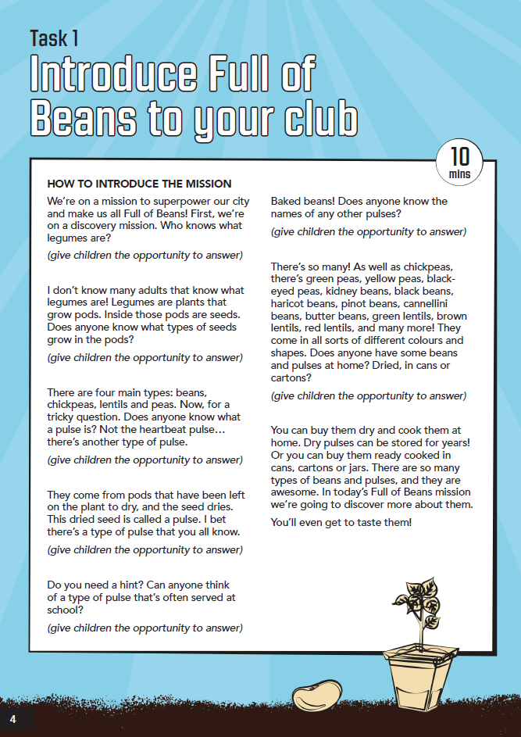
Introduce Full of Beans to your club
How to introduce the mission
“We’re on a mission to superpower our city and make us all Full of Beans! First, we’re on a discovery mission. Who knows what legumes are?
(give children the opportunity to answer)
Note: Take a look at the leader guide to find information regarding beans and pulses so you’re equipped to provide information and answer questions
Key messages to get across:
Set the scene: Why are the children completing the Full of Beans activities? To discover how brilliant beans and pulses are
Get the children thinking about what beans and pulses they’ve had before
Get the children excited for the activities ahead!
Notes:
Within the session plan there is example text of how to introduce the mission

Slide 9
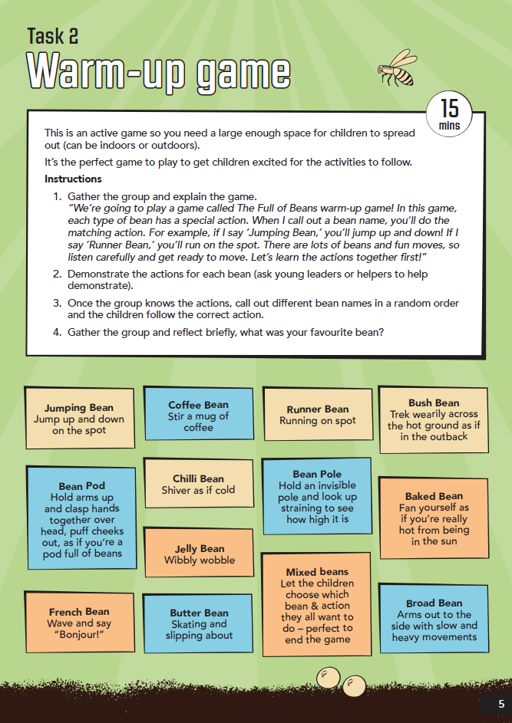
Full of Beans warm-up game
This is an active game so you need a large enough space for children to spread out (can be indoors or outdoors).
It’s the perfect game to play to get children excited for the activities to follow.
Instructions
Gather the group and explain the game
Demonstrate the actions for each bean (ask young leaders or helpers to help demonstrate).
Once the group knows the actions, call out different bean names in a random order and the children follow the correct action.
Gather the group and reflect briefly, what was your favourite bean?

Slide 10
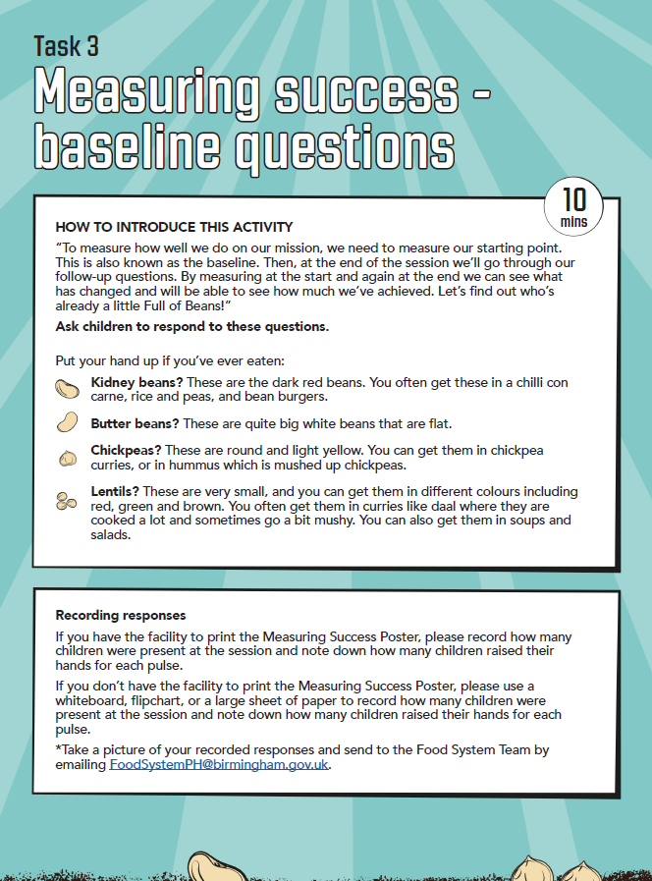
Measuring success- baseline questions
HOW TO INTRODUCE THIS ACTIVITY
“To measure how well we do on our mission, we need to measure our starting point. This is also known as the baseline. Then, at the end of the session we’ll go through our follow-up questions. By measuring at the start and again at the end we can see what has changed and will be able to see how much we’ve achieved. Let’s find out who’s already a little Full of Beans!”
Ask children to respond to these questions. Note: Use visual aid posters to provide examples of meals including the beans
Put your hand up if you’ve ever eaten:
Kidney beans?
Butter beans?
Chickpeas?
Lentils?

Slide 11
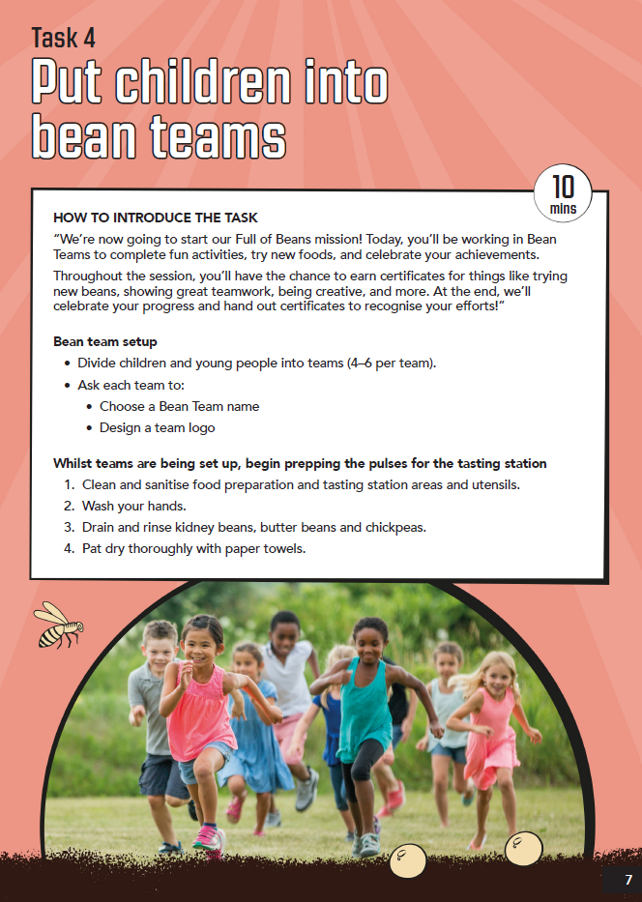
Bean Teams
HOW TO INTRODUCE THE TASK
“We’re now going to start our Full of Beans mission! Today, you’ll be working in Bean Teams to complete fun activities, try new foods, and celebrate your achievements.
Throughout the session, you’ll have the chance to earn certificates for things like trying new beans, showing great teamwork, being creative, and more. At the end, we’ll celebrate your progress and hand out certificates to recognise your efforts!”
Bean team setup
• Divide children and young people into teams (4–6 per team).
• Ask each team to:
• Choose a Bean Team name
• Design a team logo
Whilst teams are being set up, begin prepping the pulses for the tasting station

Slide 12
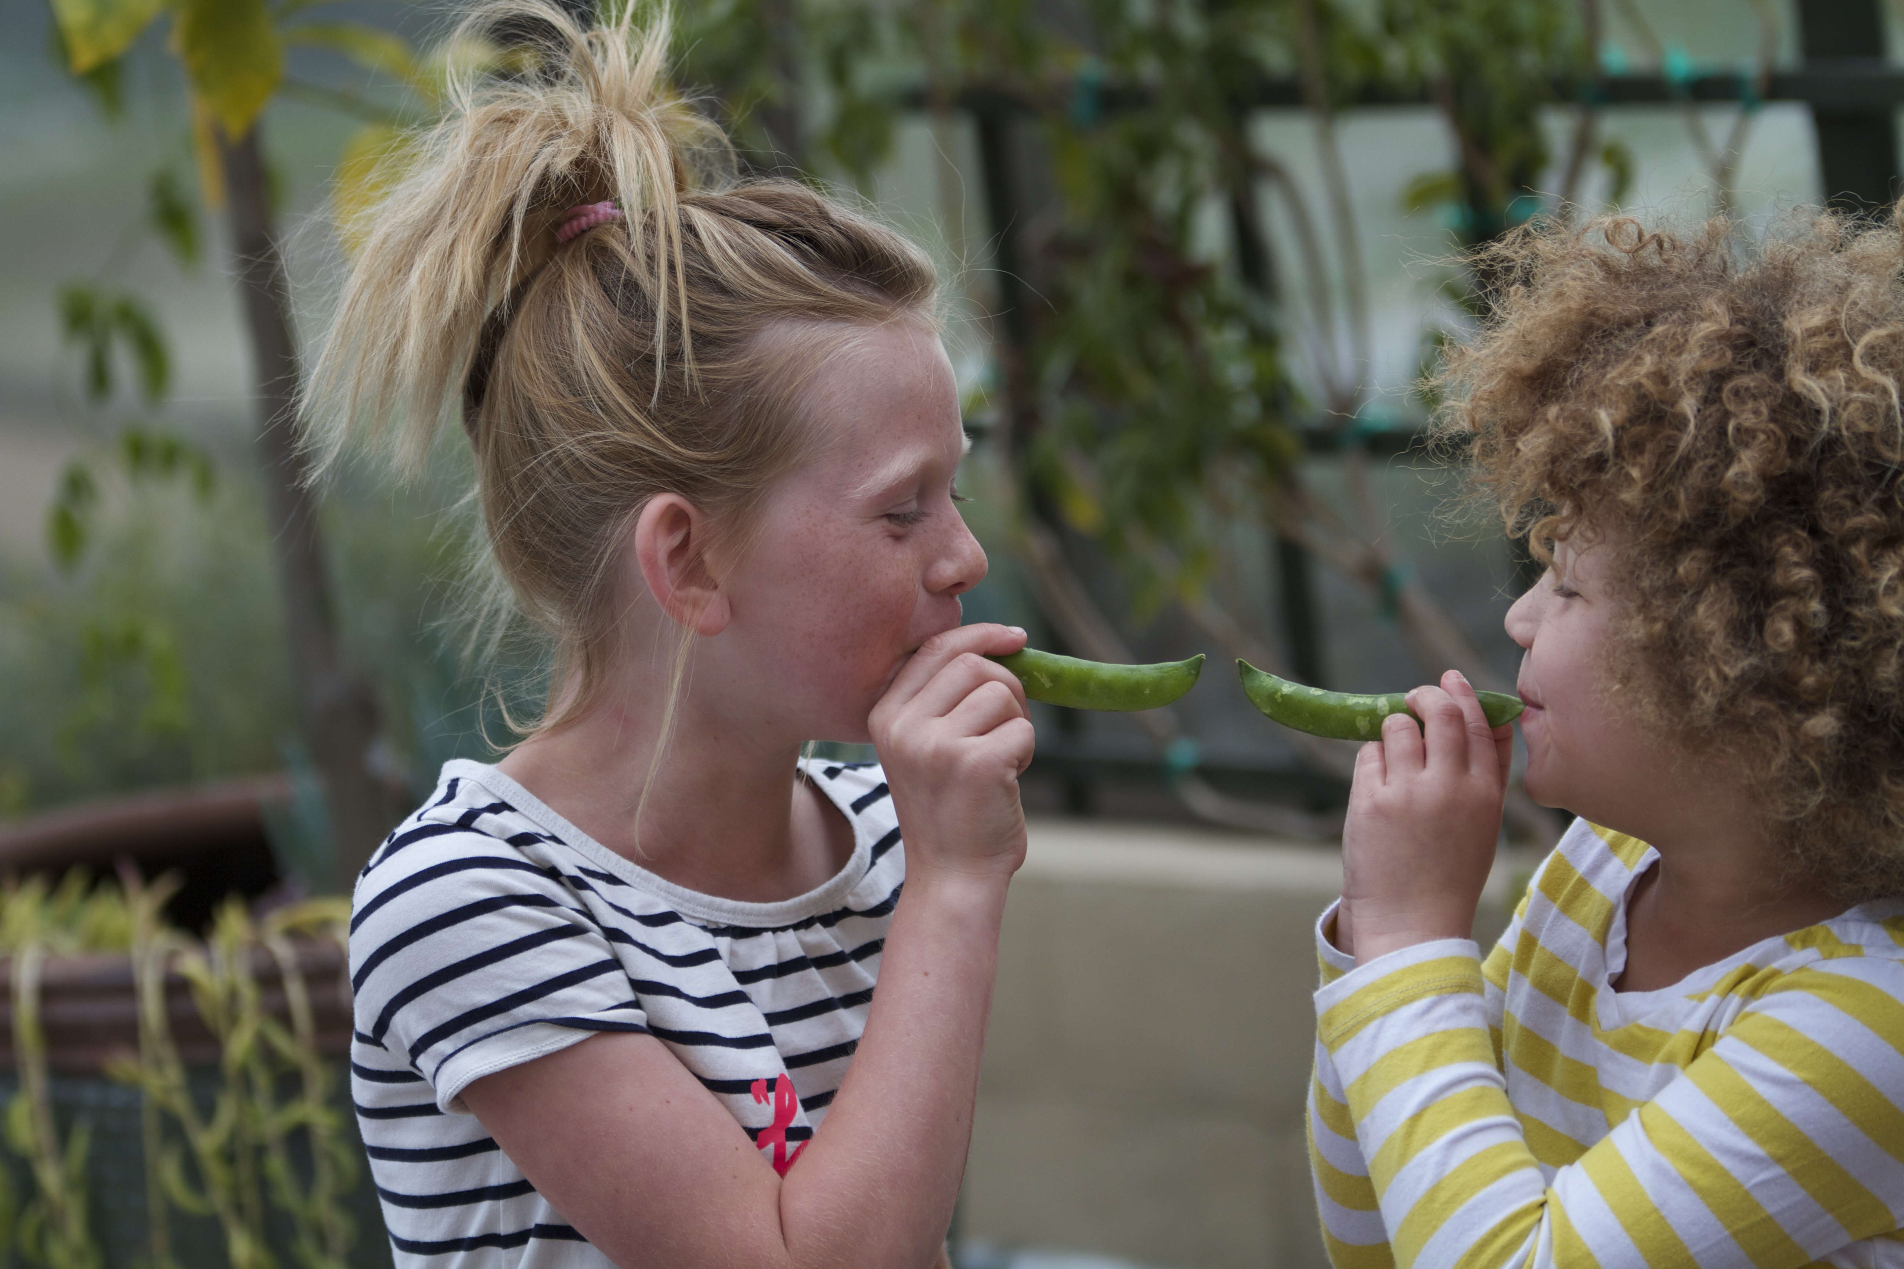
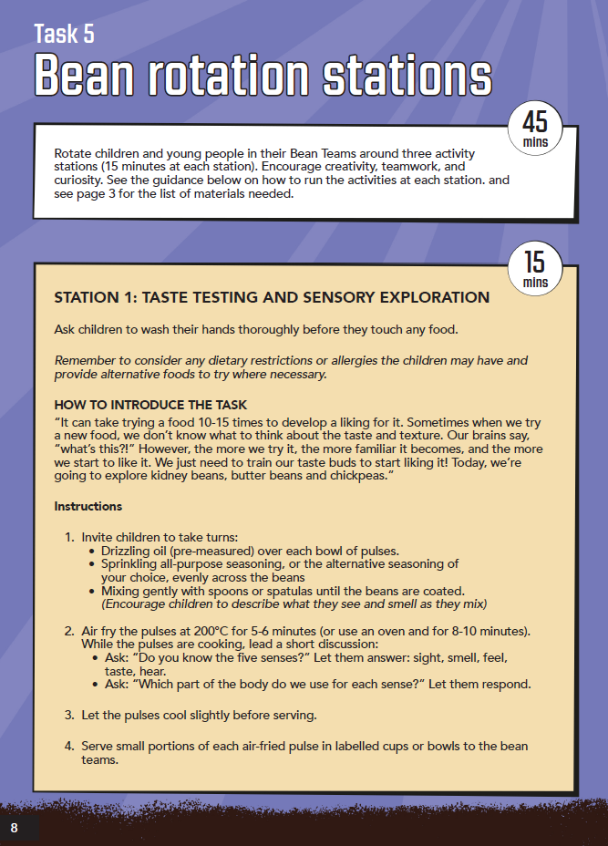
Bean rotation stations
3 Stations:
-Taste Testing
-Recipe and Menu Design
-The Full of Beans Quiz
Taste Testing
Instructions
Ensure children have washed their hands before handling food
Invite children to take turns: Drizzle pre-measured oil over bowls of pulses. Sprinkle seasoning evenly across beans. Mix gently with spoons/spatulas until coated. (Encourage describing sights and smells.)
Cook pulses: Air fry at 200°C for 5–6 mins or oven bake for 8–10 mins.
Cool and serve: Let pulses cool slightly. Serve small portions in labelled cups/bowls for each team. Taste and explore senses: Ask: What do you see, smell, feel, taste, hear? Use descriptive words (e.g., crunchy, salty, smooth, shiny).
Notes:
Outline that recipe and menu design and quiz can be substituted for other activities in the leader guide to best suite cohort for example younger children

Slide 13
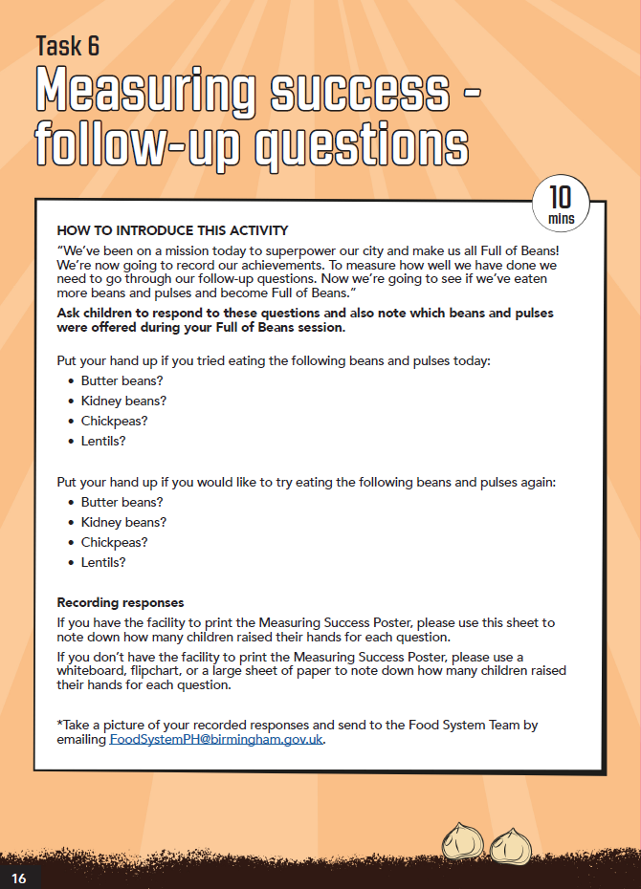
Measuring Success- follow-up questions
Ask children to respond to these questions and also note which beans and pulses were offered during your Full of Beans session.
Put your hand up if you tried eating the following beans and pulses today:
• Butter beans?
• Kidney beans?
• Chickpeas?
• Lentils?
Put your hand up if you would like to try eating the following beans and pulses again:
• Butter beans?
• Kidney beans?
• Chickpeas?
• Lentils?

Slide 14
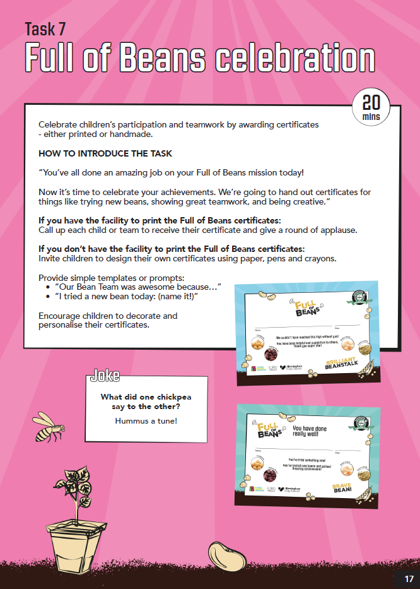
Full of Beans Celebration
Celebrate children’s participation and teamwork by awarding certificates- either printed or handmade.
HOW TO INTRODUCE THE TASK
“You’ve all done an amazing job on your Full of Beans mission today!
Now it’s time to celebrate your achievements. We’re going to hand out certificates for things like trying new beans, showing great teamwork, and being creative.”
If you have the facility to print the Full of Beans certificates: Call up each child or team to receive their certificate and give a round of applause.
If you don’t have the facility to print the Full of Beans certificates: Invite children to design their own certificates using paper, pens and crayons.

Slide 15
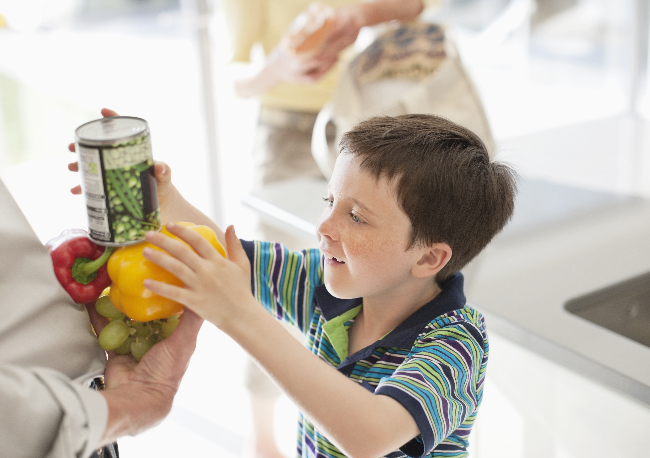
Overview
Key messages:
Introduce the Full of Beans mission well at the start to give a clear purpose to the session
The session plan gives a strong basis for a session, but please do feel free to change aspects to best suit your club! There are lots of activities in the leader guide
All resources available on Bring it on Brum portal
Reflect on roles and responsibilities and make sure your club is ready and prepared
The most important things are for children to have fun and have the opportunity to try beans and pulses! ☺

Slide 16


Thank you for
your time!
Any questions?
FoodSystemPH@birmingham.gov.uk
Search Birmingham Food Revolution
#BirminghamFoodRevolution
Notes:
.

